Slide 1
NeoLoad and API Simulation integration

Slide 2
oTel
Enterprise Performance Testing with NeoLoad
SITUATION
Performance Testing Stores complex interdependent systems & public facing applications
Performance testing of third-party billing ,logistics etc.. transactions is challenging, as the dependent system is designed for development activities and can only handle 4–5 users at a time.
Performance testing of high-volume purchase & shipping transactions is also difficult, as there is a charge of 2 USD per transaction, and the system is currently configured for manual testing activities.
NEED
Store require performance testing to ensure system scalability and service virtualization by simulating unavailable or costly dependencies during testing.
There is a critical need to perform performance testing on third-party shipping & payment to validate system behaviour under load, as the current setup supports only limited transactions and is not production-representative for 5000+ concurrent users
Performance testing of high-volume shipping transactions is essential to ensure system scalability and cost-efficiency, despite the per-transaction charge, as manual testing is insufficient for identifying performance bottlenecks.
Notes:
T-mobile

Slide 3
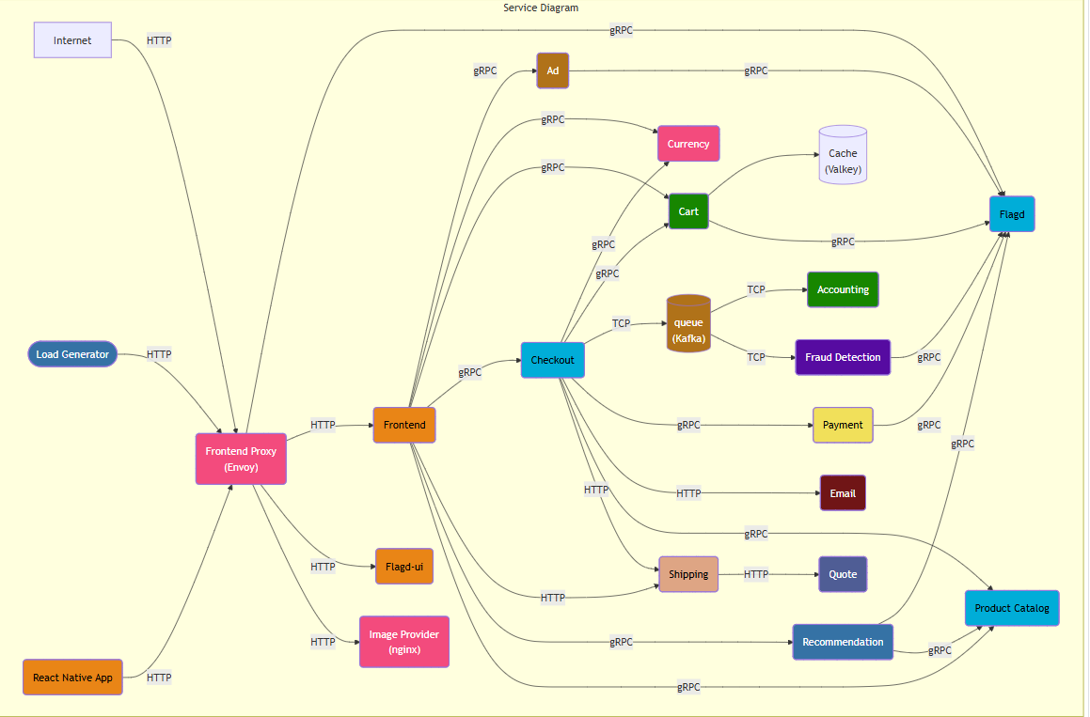
oTel service virtualization requirement
oTel primarily uses REST, SOAP, gRPC and Kafka for application integration
Estimated Virtualization Volume capacity as follows:
5,000 virtual users (VUs) calling the API services
22 days per month
12 months in a year
This results in approximately 1.32 million hits annually (5,000 VUs × 22 days × 12 months = 1.32 million). To account for additional services that might be involved, we have rounded up the requirement to 2 million hits.

Slide 4
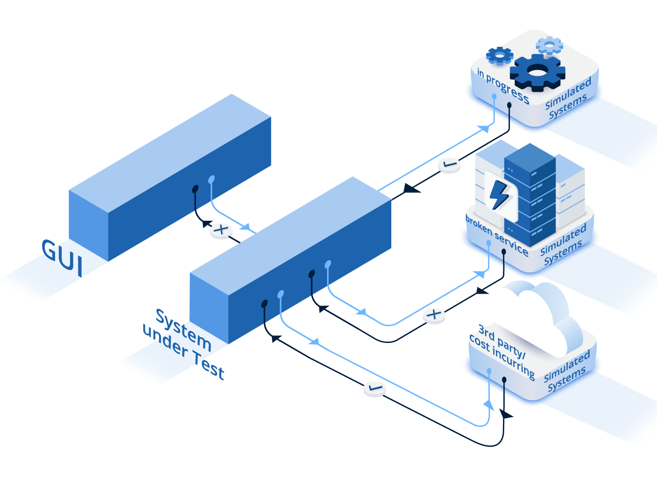
API Simulation
Eliminate Testing Delays
Easily simulate interactions with dependent components that are not available, not yet implemented or still evolving.
Enable Continuous Testing
Stabilize access to your dependent systems so that your continuous tests execute completely, reliably and accurately– every time.
Increase Automation Rates
Making API simulation accessible to all testers and developers helps the team complete more automated testing.
Notes:
Make sure the simulation designed available to entire team increase automation-collaboration feature in API sim cloud

Slide 5
demo

Slide 6





Benefits of API simulation in Performance Testing
Shift left Testing
Test early with incomplete Applications (Micoservices)
Cost Efficiency
Simulate third party calls and save cost
Test Efficiency
Test with mocking partially the system (purchase process)
Expand Testing
Test with constraints (bottlenecks simulation)
Simulation Agent
Real
Service
404 Not Found
request
Application under test
response
Not available
Connection
Failover Triggers
200 OK
200 OK
Simulation
Notes:
-Faster time to market by speeding up release cycles
-Reduce the cost by eliminating the requirement for access to constrained business critical infra, thridparty systems, or pay –per-use cloud components for testing
-increase efficiency by eliminating the bottleneck caused by application complexity & dependency

Slide 7
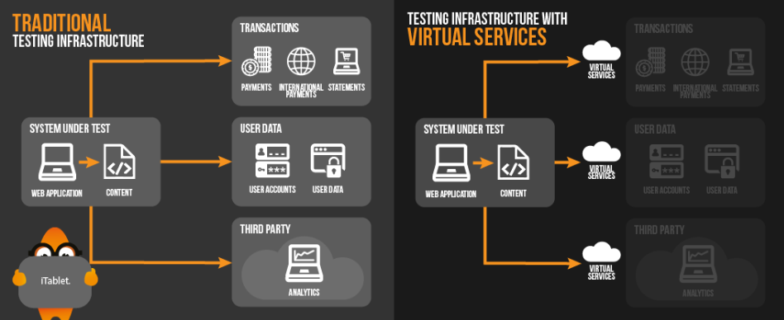
Service Virtualization

Slide 8
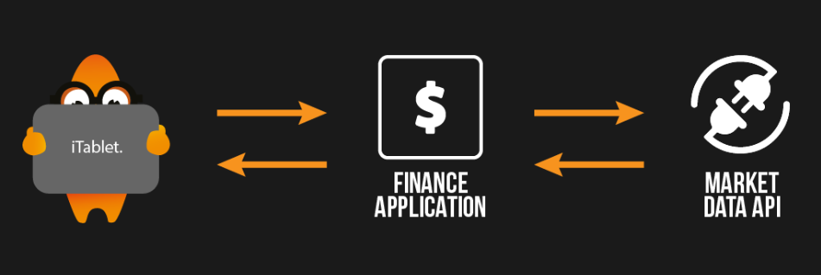
How to record Service to virtualize

Slide 9
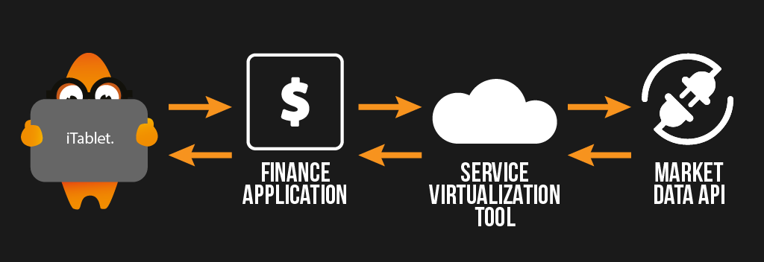
Put tool in Listener mode to record

Slide 10
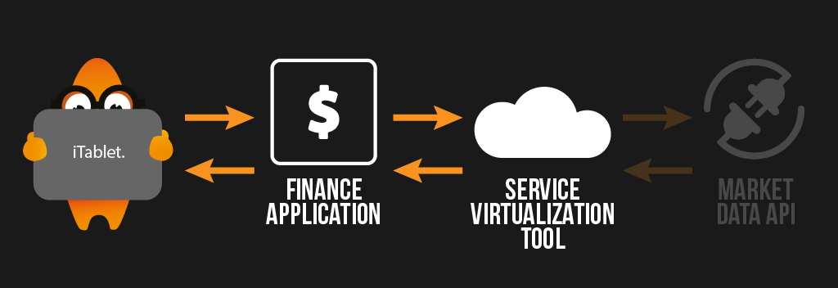
Put Tool in Simulatefirst mode

Slide 11
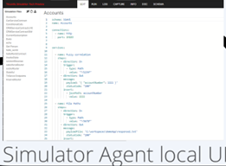
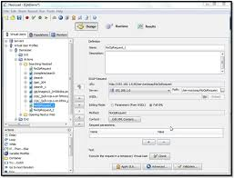
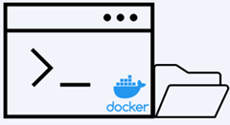



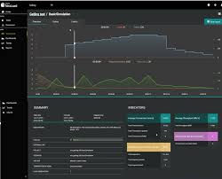


Integration Architecture-Neoload SaaS
TEST DESIGN
proxy
Sim.yaml
Tricentis Cloud
Registration & Licensing
Dynamic API Simulator
TEST EXECUTION

Slide 12
Integration Architecture-Neoload Onprem
TEST DESIGN
proxy
API Simulator Agent
Sim.yaml
Tricentis Cloud
Registration & Licensing
TEST EXECUTION

